Slide 1
Overdose Prevention and Naloxone use
CREATED BY THE NORTH FLORIDA Poly-Drug TASKFORCE Presented by The Safe and healthy neighborhood project

Slide 2
Overdose Prevention & Naloxone Administration
This training is funded by The Safe and Healthy Neighborhoods Project implemented by the Jacksonville Fire and Rescue Department and is a partnership of JFRD, the City of Jacksonville and Drug Free Duval

Slide 3
Instructions – Before Training
If you are in-person:
Open your folder please
RIGHT SIDE:
Complete the Distribution Survey
And the Pretest, Sections 1 & 2
Must complete both to receive your Narcan kit!
If you are virtual:
Have you completed the Pretest?
Must be completed to receive your NARCAN® kit!
If not, please click on the link in the chat box to both surveys and do them now!

Slide 4
Training Objectives
Be able to define Opioids
01
Become educated about the scope of the problem
02
Learn about Florida’s Overdose Prevention Laws
03
Learn how to recognize & respond to an Opioid Overdose
04

Slide 5
What are opioids/opiates?
Prescription (Rx) medication to treat and manage pain
Hydrocodone, Oxycodone, Morphine, Vicodin, Dilaudid, Fentanyl, etc.
Illicit drugs (heroin, fentanyl and fentanyl analogs)

Slide 6
What’s the problem?

Slide 7
Scope of the Problem (U.S.)
Over 72,000 drug OD deaths in U.S in 2017
48,000 (67%) of the overdose deaths were opioid caused with 30,000 (42%) of the deaths caused by a specific opioid: fentanyl and fentanyl analogs
192 people were dying a day from overdose
130 of these deaths were due to opioid overdose
Notes:
Sources:
Centers for Disease Control and Prevention. (2014). Web-based Injury Statistics Query and Reporting System (WISQARS).
Centers for Disease Control and Prevention. (2016). Increases in Drug and Opioid Overdose Deaths – United States, 2000-2014. Morbidity and Mortality Weekly Report, 64, 1378-1382.

Slide 8
Scope of the Problem (U.S.)
In 2018, CDC reported:
Opioid-involved death rates decreased by 2%
Prescription opioid-involved death rates decreased by 13.5%
Heroin-involved death rates decreased by 4%
All good news, but:
Synthetic opioid-involved death rates (excluding methadone) increased by 10%
Notes:
Sources:
Centers for Disease Control and Prevention. (2014). Web-based Injury Statistics Query and Reporting System (WISQARS).
Centers for Disease Control and Prevention. (2016). Increases in Drug and Opioid Overdose Deaths – United States, 2000-2014. Morbidity and Mortality Weekly Report, 64, 1378-1382.

Slide 9
Three Waves of Opioid OD Deaths
Wave 1: 1990s and a dramatic increase in overdose deaths involving prescribed opioids
Wave 2: Began in 2010 with rapid increases in overdose deaths involving heroin.
Wave 3: Began in 2013 with significant increases in overdose deaths involving synthetic opioids – particularly illicitly manufactured fentanyl. Today this illicit drug is found in combination with heroin, counterfeit pills, cocaine and many other drugs.

Slide 10
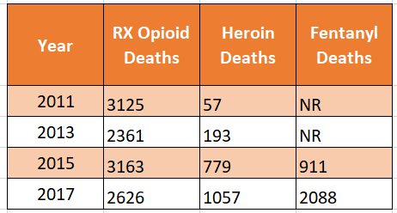
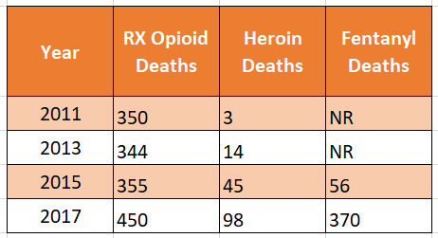
Scope of the Problem in Florida and in Northeast Florida
Florida Medical Examiner Data
State of Florida Northeast Florida

Slide 11
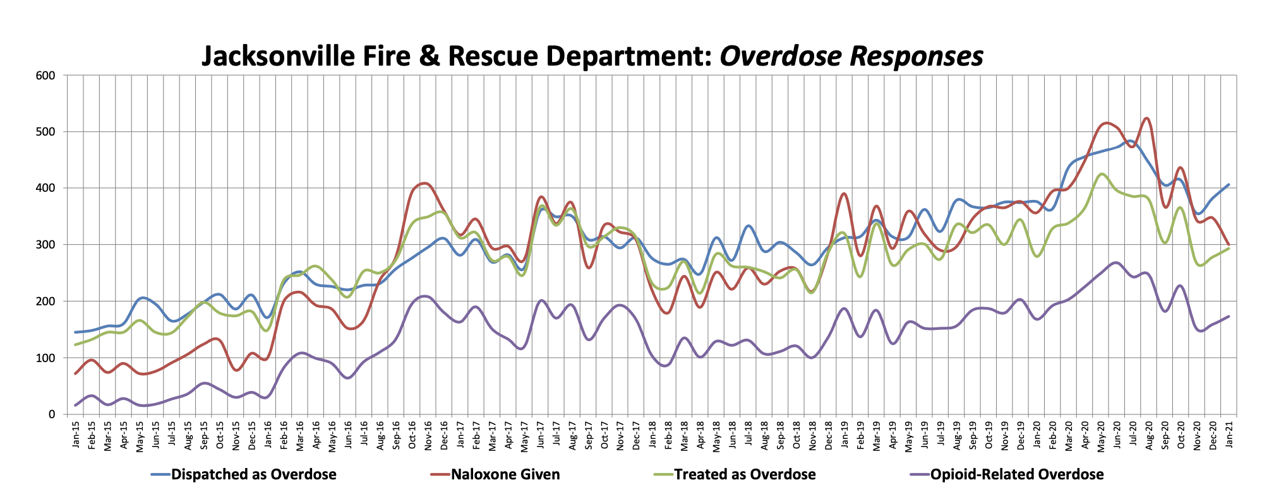
Scope of the Problem: Duval March 2015-January 2021
Notes:
In the past two years, the number of 9-1-1 calls for overdosed have tripled
The administration of Naloxone by paramedics has increased fivefold
In 2015, JFRD transported 1,903 patients suspected of an overdose at a cost of $1,895,388.00
In 2016, JFRD transported 3,156 patients suspected of an overdose at a cost of $3,143,376.

Slide 12
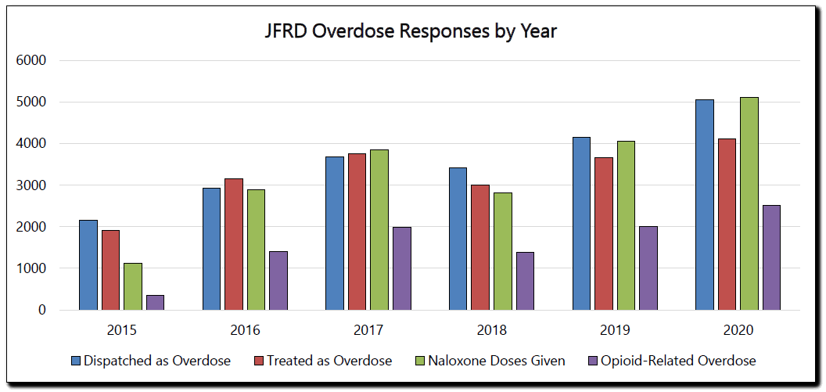
Scope of the problem: Duval 2015 - 2020
JFRD REPORTED A 27% SPIKE IN OVERDOSE CALLS
Notes:
Opioid-Related Overdose Calls
36% increase YTD 2019 to 2020
90% increase YTD 2018 to 2020

Slide 13
How is Northeast Florida Responding?

Slide 14
North Florida Poly-Drug Task Force
More than 200 members implementing community-based strategies
Three Committees
Healthcare Education and Training
Community Education and Training
Employer Workforce
Upcoming Task Force Meeting
May 14, 2021 at noon: Meeting virtually - join us!
RSVP: susan@drugfreeduval.org

Slide 15
Marriage of Prevention & Harm Reduction
Prevention reduces risk behavior
Provides information
Enhances skills & training
Brings support for healthy activities
Reduces barriers to health & increases access
Develops incentives for healthy behaviors & disincentives for harmful choices
Rethinks physical design
Advances great policy of support
Notes:
SEP = syringe exchange program
MAT = medication assisted treatment

Slide 16
Marriage of Prevention & Harm Reduction
AKA risk reduction
Strategies/ideas aimed at reducing negative consequences associated with drug use
Strategies that meet people in their situation
Could mean safer use, managed use, abstinence – depends on the individual
Examples: Syringe Exchange Programs, Medication Assisted Treatment, safe sex education, seat belts
Notes:
SEP = syringe exchange program
MAT = medication assisted treatment

Slide 17
Critical Legislation
Good policy impacts the entire community

Slide 18
Overdose Prevention Legislation
911 Good Samaritan Act
Emergency Treatment and Recovery Act

Slide 19
911 Good Samaritan Act
Encourages people to call for help during a life-threatening overdose.
In many overdose situations, an individual is at the scene who can intervene and call 911 and administer naloxone.
Yet, in 50% of overdose cases, no one called 911. The number one reason was fear of arrest/police involvement.

Slide 20
Florida 911 Good Samaritan Act
SB 278 passed during 2012 legislative session and was effective October 1, 2012 s. 893.21, F.S.
In an overdose situation, the law protects the person who calls 911 (caller/help-seeker) and the overdose victim from:
Being charged, prosecuted, or penalized for possession of controlled substances (if found as result of seeking emergency medical care)

Slide 21
Florida 911 Good Samaritan Act: Limitations
No protections for drug paraphernalia/possession with intent to distribute or an amount/weight considered trafficking
In some areas, there is low awareness among law enforcement and prosecutors about the Good Samaritan Law – you may need to self-advocate
The law was amended in October, 2019 to remove penalties & prosecution for the following:
Use of alcohol by underage persons, providing alcohol to underage persons, violation of pre-trial release, probation, or parole, and expanding immunity for a mis-identified overdose

Slide 22
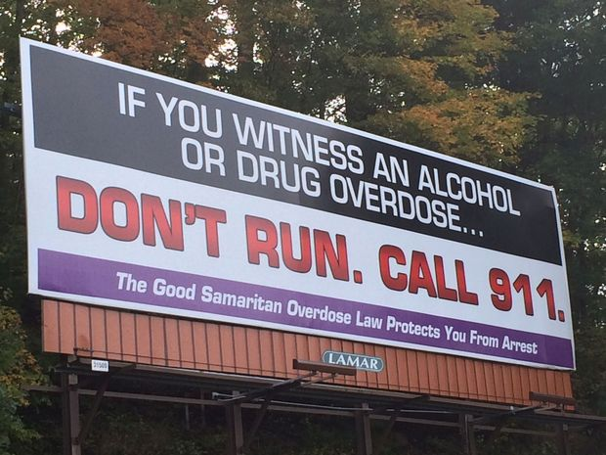
Notes:
911 Good Samaritan flier examples

Slide 23
Florida Naloxone Law
HB 751 passed during 2015 legislative session, becoming effective June 10, 2015
Called: Emergency Treatment & Recovery Act, s. 381.887, F.S.
Was expanded in 2016 with the passage of HB 1241 – created standing order

Slide 24
Florida Naloxone Law
Allows licensed practitioners to prescribe naloxone to anyone at risk of experiencing or witnessing an opioid-related overdose
Prescribers are immune from any civil or criminal liability for prescribing naloxone, pharmacists are immune for dispensing

Slide 25
Florida Naloxone Law
ALSO PROVIDED:
Third party Rx – prescribing a medication to someone with the intent that they will use it on someone else (friend/family of person overdosing)
Necessary component: no one can use naloxone on themselves
Emergency responders (law enforcement, paramedics, EMTs) and laypersons in the community can possess, store, and administer naloxone to someone believed in good faith to be experiencing an opioid overdose

Slide 26
Florida Naloxone Law - Expanded
Effective July 1, 2016
Pharmacists can prescribe and dispense naloxone via standing order (auto-injector, nasal spray)
Reduces barriers to naloxone
No need for doctor appointment (fees, transportation, time off work), stigma
Similar to CVS operating under a standing order to administer flu shots to the general public
Notes:
Standing order: Prescribers write an order covering distribution by designated, trained personnel to patients and caregivers who might be unknown to the prescriber at the time of the order.
All CVS and all Walgreens in Florida are now operating under standing order – however, every pharmacist who is working at these stores needs to be educated about the new policy or they could accidentally turn people away. Also, not all pharmacies stock the medication, so you may have to call and request an order first and then come pick it up when it has arrived

Slide 27
Recognizing and Responding to Opioid Overdose

Slide 28
What happens in an opioid overdose?
User experiences:
Pain relief
Intoxication
Respiratory depression
Death
Notes:
1st you experience pain relief, if you ingest more opioids you experience intoxication/getting high, ingesting more starts to cause respiratory depression (shallow or no breathing), which can result in death = in an opioid overdose you die from lack of oxygen due to the respiratory depression

Slide 29
Notes:
Opioids bind to/fit on certain brain receptors like a key fitting into a lock

Slide 30
Who is at risk for opioid overdose and why?
People using Rx opioids as prescribed
People mixing drugs (Opiates with alcohol and/or cocaine, benzodiazepines (Xanax)
People with history of opioid abuse being released from jail/prison or discharged from drug treatment, especially abstinence-based (low tolerance)
Notes:
Rx = prescription

Slide 31
Who is at risk for opioid overdose and why?
People in medication-assisted treatment protocol
People using heroin depending on the quality of the drug
People in community response roles who may come in contact with an opioid in the field. (Law Enforcement, EMS, Physicians, etc.)

Slide 32
Signs of Opioid Overdose
Unresponsive
Blue/pale skin, lips, nails
Slow heartbeat
Slow/irregular breathing, or no breathing at all
Choking, gargling, snoring sound, “death rattle”
Vomiting
Passing out

Slide 33
Overdose Reversal Untruths
Letting the person “sleep it off”
Putting the person in cold shower/bath
Induce vomiting
Giving the person coffee or water
Beating, punching, or kicking the person
Injecting the person with other substances (saltwater, stimulants, milk, etc.)
Notes:
People resort to these types of reversal myths when they are not given proper overdose recognition and response training, when they are scared to call 911, and when they do not have access to naloxone
None of this will truly work if experiencing a fatal overdose - THE PERSON NEEDS NALOXONE to reverse the respiratory depression and allow them to start breathing again

Slide 34
Responding to an Opioid Overdose
Sternal Rub
Call 911
Administer Narcan/ Naloxone
Recovery Position

Slide 35
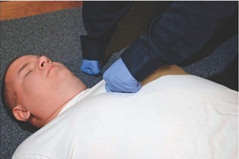
Check Responsiveness – Sternal Rub
Lay person on their back
Make a fist with your hand, and press on chest or upper lip of unresponsive individual
If no response, move to next step (call 911)

Slide 36
Call 911
Person is unresponsive and not breathing
Clearly state address and give as much information as possible
Notes:
Florida has a 911 Good Samaritan law that protects the person who calls 911 (caller/help-seeker) and the person overdosing (overdose victim) from charge or prosecution for possession of controlled substances, if the substances are found as a result of help-seeking for the overdose (this law is explained in more detail towards the end of the presentation)

Slide 37
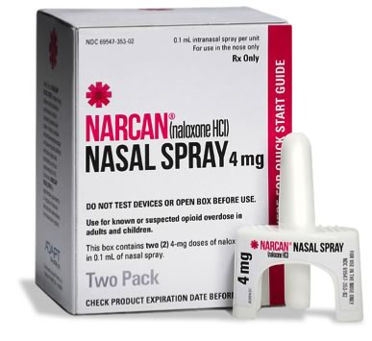
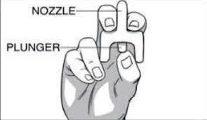
Administer Narcan

Slide 38
Administer Narcan
Peel back package to remove device (do not remove prior to use)

Slide 39
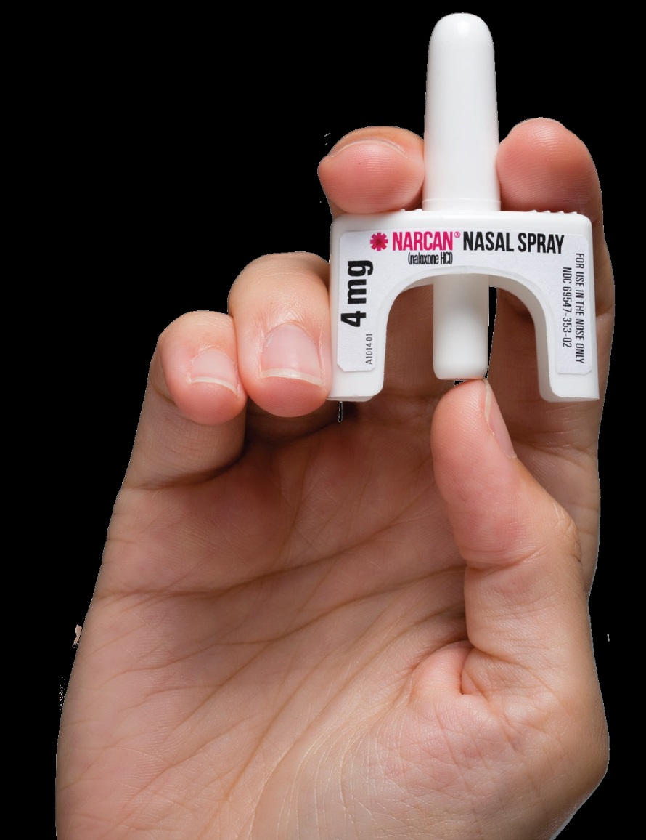
Administer Narcan
Place one finger each on either side of the nozzle, place thumb on the plunger
DO NOT PRESS PLUNGER BEFORE READY TO USE – IT WILL WASTE THE NARCAN!!!

Slide 40
Administer Narcan
Place the tip of the nozzle in either nostril of overdose victim until your fingers touch the bottom of the person’s nose

Slide 41
Administer Narcan
Press the plunger firmly to release the dose into the person’s nostril (full dose goes into one nostril)

Slide 42
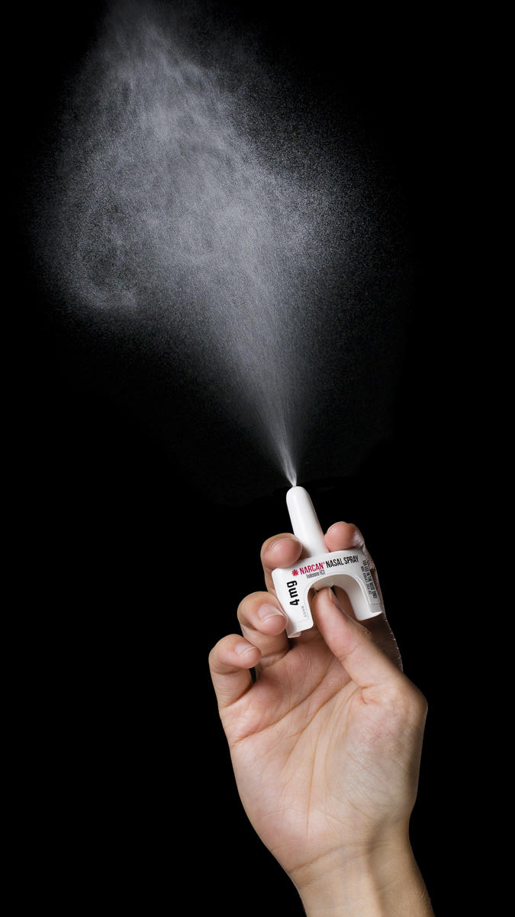
Do I need the second dose?
After you give 1st dose:
Remove device from nostril
Perform CPR if you are CPR certified
If person is not awake within 2-3 minutes, give 2nd dose in OTHER nostril, and continue CPR until person wakes up

Slide 43
Administer Narcan
Person does NOT have to be breathing for Narcan Nasal Spray to reverse an opioid overdose
Narcan gets absorbed into nasal mucous membrane (whether or not person is breathing)
Notes:
In fact, person probably will most likely be barely breathing or not breathing at all if overdosing – nasal naloxone will still work

Slide 44
Recovery Position
Knee prevents person from rolling onto stomach
Hand supports head

Slide 45
All About Naloxone
FDA approved Rx medication
Safe and effective - reverses opioid overdose (opioid/opiate antagonist)
Used by paramedics for 40+ years
Cannot be abused or cause overdose, not psychoactive
Does not work on other overdoses (cocaine, alcohol, benzodiazepines, etc.)
If naloxone is administered to someone not overdosing opioids, it has no adverse effects
This is NOT suboxone or naltrexone (Vivitrol), which are MAT medications

Slide 46
How Narcan Works

Slide 47
Narcan
Restores breathing and consciousness
Onset: 2-3 minutes
Duration: 30-90 minutes
Person can slip back into overdose after Narcan wears off, should be supervised under medical care, may need additional doses of Narcan
DO NOT leave someone alone after they wake up from Narcan

Slide 48
Side Effects of Narcan
Withdrawal symptoms in opioid-dependent individuals:
Fatigue
Loss of bowel/bladder function
Fever, sweating
Upset stomach/vomiting
Confusion, disorientation, or agitation
Increased heart rate/breathing
Pain/aches
Sometimes severe, but still alive

Slide 49
Narcan Storage
Shelf life of 18-24 months(future Narcan will have 3 year expiration date)
Keep out of direct sunlight
Store at 59-77°F (15-25°C)
Temperature “excursions” permitted up to 104°F

Slide 50
Narcan Cost
Community based pricing = ~$130 locally
Insurance coverage & copays may differ – you may pay as little as $0 or as much as full price
Current Florida Medicaid policy covers the full cost
Pricing for Public Service Officials = $75
$37.50 per dose
Available for government agencies, LEOs, non-profits
Notes:
Mention Good RX. com (app and website for pricing medicine and sometimes has coupons for Narcan)

Slide 51
Naloxone: Myth vs. Fact

Slide 52
Misconceptions About Naloxone
Myth: Naloxone provides a safety net to active users, encourages or increases drug use, and sends the wrong message.
Fact: Studies show Naloxone can increase users’ desire to seek drug treatment.
Notes:
Also, unpleasant withdrawal symptoms, no active drug user will aim to overdose to be revived with naloxone (waste entire supply, go through withdrawal, not be able to get high for hours)
Fire extinguishers do not cause someone to start a fire or play with matches, epi pens do not cause or encourage allergic reactions, seat belts do not encourage car accidents, snake bit kits do not encourage people to play with venomous reptiles
The only message naloxone sends is that we value the lives of people who use drugs

Slide 53
Misconceptions About Naloxone
Myth: Naloxone will replace calling 911.
Fact: All overdose prevention programs teach people to call 911. Naloxone is meant to keep people alive long enough for EMS to arrive and provide medical care, if necessary.

Slide 54
Misconceptions About Naloxone
Myth: Naloxone will prevent drug users from seeking treatment.
Fact: Death prevents people from seeking treatment.

Slide 55
Misconceptions About Naloxone
Myth: A person under the influence of drugs cannot be trusted to respond appropriately to an overdose.
Fact: Everyone, including active drug users, can be trained in OD recognition/response. Many overdose reversals occurred in the community by active drug users.

Slide 56
Misconceptions About Naloxone
Myth: Naloxone ALWAYS makes people violent.
Fact: People often are agitated after reversal. It is unusual for them to become violent. The “fight or flight” response is real, however the risk of out-of-control violence is minimal. EMS responders are well trained – another reason to make that call!
Ultimately the chance at saving a life is worthwhile.

Slide 57
Impact of Naloxone
Since starting this training in December 2019, EIGHTEEN LIVES HAVE BEEN SAVED by people like you
Right here in Jacksonville, FL

Slide 58
Community Contacts:
24-7 LSF Access to Care Line staffed by a nurse ready to help direct you to the best place in your situation: 877-229-9098
For Suicide Risk: Call the National Suicide Prevention Lifeline: 800-273-8255
OR text “home” to 741741 which is the Crisis Text Line
United Way’s Crisis Intervention Line: Dial 2-1-1

Slide 59
Instructions – After Training
If you are in-person:
Open your folder please
Complete the Post-Test, Sections 1 & 2
Must complete it to receive your Narcan kit!
If you are virtual:
Have you completed the Post-test?
Must be completed to receive your NARCAN® kit!
If not, please click on the link in the chat box to the survey and do it now!
IF YOU USE YOUR NARCAN:
Report it anonymously at bit.ly/narcanuse - this link is in the Project Summary document and on a label on your Narcan kit
You can also contact Drug Free Duval at info@drugfreeduval.org
When you submit your survey or contact Drug Free Duval you will receive information about getting a replacement kit

Slide 60
Additional education & trainings by Drug Free Duval:
Signs & Symptoms of Drug Misuse
Drug Sharing in the State of Florida
Safe Storage & Safe Disposal (includes Deterra disposal bags for participants)
Neonatal Abstinence Syndrome: Preventing Substance Exposed Newborns
Know the Law
Natural High
Tools of Engagement for Parents & Caregivers
Strategic Prevention Framework: Creating Community Change
The DFD Team:
Sally Finn
Sally@drugfreeduval.org
Susan Pitman
Susan@drugfreeduval.org
Hannah Schaper
Hannah@drugfreeduval.org

